Slide 1
5th Grade Science
FCAT 2.0 Review

Slide 2
For teachers:
The purpose of this presentation is to help teachers review the material required for the Science FCAT 2.0.
All of the assessed benchmarks from 3rd-5th grade are covered using videos, online activities, and probing questions.
Some suggestions for use:
-Whole class review via white board
-Small group/center review on computer
-Individualized formative assessment to determine what review is needed

Slide 3
Powerpoint Index
Nature of Science Slides 4-18
Earth Science Slides 19-53
Physical Science Slides 54-98
Life Science Slides 99-125

Slide 4
Nature of Science
Conducting Experiments

Slide 5
Benchmark Clarifications
SC.5.N.1.1 Students will evaluate a written procedure or experimental setup. Students will identify appropriate forms of record keeping. Students will interpret and analyze data to generate appropriate explanations based on that data. (SC.3.N.1.1, SC.4.N.1.1)
SC.4.N.1.6 Students will identify examples of or distinguish among observations, predictions, and inferences.
SC.5.N.1.2 Students will explain the difference between an experiment and other types of scientific investigations.
SC.5.N.1.4 Students will identify a control group and explain its importance in an experiment.

Slide 6
Is this an experiment? Why or why not?
Sofie wants to determine whether salt will dissolve faster in hot water with stirring, hot water without stirring, cold water with stirring, or cold water without stirring.
She puts 20 g of salt into 4 different beakers; two have hot water and two have cold water. She begins stirring in two of the beakers and starts the stopwatch.
She makes a note of the time when the salt completely dissolves in each beaker.
SC.5.N.1.1 (SC.3.N.1.1, SC.4.N.1.1), SC.5.N.1.4
Notes:
This is an experiment because variables are being manipulated. Ask students what she could use as a control. Ask how the experiment could be improved.
SC.5.N.1.1 Students will evaluate a written procedure or experimental setup. (SC.3.N.1.1, SC.4.N.1.1)
SC.5.N.1.4 Students will identify a control group and explain its importance in an experiment.

Slide 7
How would you collect data from this experiment?
Sofie needs to create a data table to organize the information she collected.
SC.5.N.1.1 (SC.3.N.1.1, SC.4.N.1.1)
Notes:
Have students create a table that would be appropriate for collecting data. Look for labels on the columns and units of time.
SC.5.N.1.1 Students will identify appropriate forms of record keeping. (SC.3.N.1.1, SC.4.N.1.1)

Slide 8
Which graph would be best to use? Why?
Time for salt to dissolve
Time for salt to dissolve
SC.5.N.1.1 (SC.3.N.1.1, SC.4.N.1.1)
Notes:
The bar graph is more appropriate because the data is discrete. Ask students to create an explanation based on the data presented.
SC.5.N.1.1 Students will interpret and analyze data to generate appropriate explanations based on that data. (SC.3.N.1.1, SC.4.N.1.1)

Slide 9
Label each as a prediction, observation, or inference
Sofie believes that the molecules in the hot water moved around more which helped the salt dissolve.
Sofie thinks stirring the water will help dissolve the salt.
Sofie sees that the salt in the hot water with stirring has dissolved fastest.
SC.4.N.1.6
Notes:
Inference, prediction, observation
SC.4.N.1.6 Students will identify examples of or distinguish among observations, predictions, and inferences.

Slide 10
Nature of Science
Observations and Evidence

Slide 11
Benchmark Clarifications
SC.5.N.2.1 Students will identify and explain that science is grounded in verifiable observations (empirical) that are testable. (SC.3.N.1.7, SC.4.N.1.7)
SC.5.N.1.5 Scientific investigation frequently does not parallel the steps of "the scientific method." (SC.4.N.1.3)
SC.5.N.1.6 Students will distinguish between personal interpretation and verified observation. Students will distinguish between examples of evidence or observations (empirical) and personal opinions.

Slide 12
Animal Behaviors
Planet Earth: Birds of Paradise
Think about:
What behaviors are you observing?
What are some testable questions you have?
(How could you test them?)
SC.5.N.2.1 (SC.3.N.1.7, SC.4.N.1.7)
SC.5.N.1.5 (SC.4.N.1.3)
Notes:
The video shows a variety of birds in a jungle. Should be watched without sound. May want to get it set up ahead of time because ads usually precede the clip. Students should watch the animal behaviors and write down what they see
SC.5.N.2.1 Students will identify and explain that science is grounded in verifiable observations (empirical) that are testable. (SC.3.N.1.7, SC.4.N.1.7)
SC.5.N.1.5 Scientific investigation frequently does not parallel the steps of "the scientific method." (SC.4.N.1.3)

Slide 13
Are these observations or inferences?
Colorful birds attract mates.
There is a great variety of birds in the jungle.
The males are more colorful than the females.
The birds dance to scare off other birds.
Many of the birds in the jungle are colorful.
SC.5.N.1.6
Notes:
Add additional examples from what the kids wrote down. Be sure to identify any observations (things they specifically saw) vs inferences (things they assume based on what they saw).
SC.5.N.1.6 Students will distinguish between personal interpretation and verified observation. Students will distinguish between examples of evidence or observations (empirical) and personal opinions.

Slide 14
Which of these are observations and which are opinions?
The birds are beautiful.
The birds were changing their appearance.
The jungle is a nice place to live.
The jungle floor is shaded.
SC.5.N.1.6
Notes:
Add additional examples from what the kids wrote down. Be sure to clarify opinions vs fact

Slide 15
Nature of Science
Repeatable and Replicable

Slide 16
Benchmark Clarifications
SC.5.N.2.2 Students will identify and explain the need for replication of scientific investigations.
SC.4.N.1.2 Students will explain the reason for differences in data across groups as a result of using different tools and procedures. (SC.3.N.1.2, SC.3.N.1.5, SC.4.N.1.5)
SC.5.N.1.3 Students will identify and explain the need for repeated trials in a scientific investigation.

Slide 17
Replication
Thomas conducted research to create a new kind of fuel made from water. He collected his data and presented his findings to a group of scientists, but when they asked him to explain his procedures he shared that he did not write them down. Everyone dismissed his results.
Why is it important for other people to have access to Thomas’s procedures?
SC.5.N.2.2
Notes:
So that they can replicate his experiment to validate his results; one experiment with one result does not “prove” something, if multiple people can do the same experiment and get the same results then the findings are more valid
SC.5.N.2.2 Students will identify and explain the need for replication of scientific investigations.

Slide 18
Repetition
Emily and David conducted the same experiment on the effect of fertilizer on plant growth. Their results are shown in the graphs below.
Which experiment was better? Explain why
SC.4.N.1.2 (SC.3.N.1.2, SC.3.N.1.5, SC.4.N.1.5), SC.5.N.1.3
Notes:
Emily’s because she had multiple plants for each fertilizer, similar issue with replication only this involves doing the same experiment again by the same person and typically having multiple trials going at the same time rather than after the fact
SC.4.N.1.2 Students will explain the reason for differences in data across groups as a result of using different tools and procedures. (SC.3.N.1.2, SC.3.N.1.5, SC.4.N.1.5)
SC.5.N.1.3 Students will identify and explain the need for repeated trials in a scientific investigation.

Slide 19
Earth Science
Galaxies and the Sun

Slide 20
Benchmark Clarifications
SC.5.E.5.1 Students will identify the basic components of a galaxy.
SC.3.E.5.1 Students will explain how some stars are smaller, some are larger, and some appear brighter than others
SC.3.E.5.2 Students will identify the Sun as a star that emits energy.
SC.3.E.5.3 Students will identify that the Sun’s appearance is due to its proximity to Earth.

Slide 21
Our Galaxy
Animated Galaxy
Think about:
What objects are inside of the galaxy?
SC.5.E.5.1
Notes:
Answers will vary
SC.5.E.5.1 Students will identify the basic components of a galaxy.

Slide 22
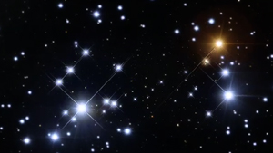
Appearance of Stars
If the two stars indicated above are actually the same size, what can you say about their distances from Earth? Explain your answer
SC.3.E.5.1
Notes:
The star on the left must be further away since it is smaller
SC.3.E.5.1 Students will explain how some stars are smaller, some are larger, and some appear brighter than others

Slide 23
The Sun
Rotating Sun
Think about:
-What do you observe?
-Why can’t we see the Sun like this from Earth?
SC.3.E.5.2, SC.3.E.5.3
Notes:
Focus on the heat and light energy that is continuously leaving the surface. Talk about the distance of the Sun from Earth which keeps us from seeing the details of the surface but allows it to be clearly visible in our sky (further away on more distant planets in our solar system, the Sun would just look like a large star).
SC.3.E.5.2 Students will identify the Sun as a star that emits energy.
SC.3.E.5.3 Students will identify that the Sun’s appearance is due to its proximity to Earth.

Slide 24
Earth Science
Solar System

Slide 25
Benchmark Clarifications
SC.5.E.5.3 Students will distinguish among objects in our solar system based on their relative positions and their characteristics.
SC.5.E.5.2 Students will identify common characteristics of all planets and compare and contrast the common characteristics of inner and outer planet groups.

Slide 26
Objects in the Solar System
C
B
A
Label the objects above as either moon, star, or planet. Explain why you labeled them as you did.
SC.5.E.5.3
Notes:
Allow the students to observe the motion. Students should explain that moons orbit planets and planets orbit stars. Colors were purposely selected to be contrary to typical (ie blue sun and red moon) to make sure the concept is mastered.
SC.5.E.5.3 Students will distinguish among objects in our solar system based on their relative positions and their characteristics.

Slide 27
Inner vs. Outer Planets
Virtual Solar System
Think about:
The information you learned and how you can use it to complete the chart.
 | Inner Planets | Outer Planets
Surface (solid/gas)
Atmospheres (thick/thin)
Distance from Sun (closer/farther)
Moons (few or none/many)
Rings (none/many)
Temperature (higher/lower)
Length of Year (shorter/longer)
SC.5.E.5.2
Notes:
After students walk through the virtual solar system, have them complete the chart.
Inner: solid, thin, closer, few or none, none, higher, shorter
Outer: gas, thick, farther, many, many, lower, longer
SC.5.E.5.2 Students will identify common characteristics of all planets and compare and contrast the common characteristics of inner and outer planet groups.

Slide 28
Earth Science
Earth-Moon-Sun

Slide 29
Benchmark Clarifications
SC.4.E.5.4 Students will describe how the rotation of Earth and apparent movement of the Sun, Moon, and stars are related.
SC.4.E.5.1 Students will identify that the pattern of stars appears to shift across the sky nightly or that different stars can be seen in different seasons.
SC.4.E.5.2 Students will describe the visual changes in the appearance of the Moon.
SC.4.E.5.3 Students will explain that Earth revolves around the Sun in a year. Students will explain that Earth rotates on its axis in a 24-hour day.

Slide 30
Appearance of Stars
Planetarium
Think about:
Observe what happens as you scroll through one day. Then observe what happens as you scroll through one month. What causes these changes?
SC.4.E.5.4, SC.4.E.5.1
Notes:
This site has other resources but the focus for this benchmark is understanding how the patterns in the sky change over time. The apparent changes throughout a day would be caused by the Earth’s rotation and the apparent changes throughout a month would be caused by the Earth’s orbit around the Sun
SC.4.E.5.4 Students will describe how the rotation of Earth and apparent movement of the Sun, Moon, and stars are related.
SC.4.E.5.1 Students will identify that the pattern of stars appears to shift across the sky nightly or that different stars can be seen in different seasons.

Slide 31
Moon Phases
Lunar Cycle Challenge
Think about:
Does the Moon’s appearance change in a specific way (is there a pattern)? Explain
SC.4.E.5.4, SC.4.E.5.2
Notes:
Answers may vary
SC.4.E.5.4 Students will describe how the rotation of Earth and apparent movement of the Sun, Moon, and stars are related.
SC.4.E.5.2 Students will describe the visual changes in the appearance of the Moon

Slide 32
Revolution and Rotation
Earth's Motion
Think about:
How long does it take for Earth to complete one rotation? One revolution?
SC.4.E.5.4, SC.4.E.5.3
Notes:
The first clip shows the Earth rotating, students need to know that this takes approx 24 hours. The second clip shows the Earth revolving around the Sun, students need to know that this takes 1 year or approx 365 days. Students need to know that these motions account for the changing appearance of the Moon, Sun, and star patterns throughout a day/year but not how these motions relate to seasons, eclipses, or tides.
SC.4.E.5.4 Students will describe how the rotation of Earth and apparent movement of the Sun, Moon, and stars are related
SC.4.E.5.3 Students will explain that Earth revolves around the Sun in a year. Students will explain that Earth rotates on its axis in a 24-hour day.

Slide 33
Earth Science
Rocks and Minerals

Slide 34
Benchmark Clarifications
SC.4.E.6.2 Students will identify and describe the physical properties of common minerals. Students will describe and explain the role of minerals in the formation of rocks.
SC.4.E.6.1 Students will identify the three categories of rocks and how they were formed.

Slide 35
Minerals
Mineral Virtual Lab
Think about:
What characteristics of minerals are used to identify them?
SC.4.E.6.2
Notes:
Focus is not on knowing the individual minerals but on the types of properties used to distinguish one from another. Site has a properties of minerals book to compare to. Sound must be on so students can hear whether their identification is correct. Instructions are on the left hand side.
SC.4.E.6.2 Students will identify and describe the physical properties of common minerals. Students will describe and explain the role of minerals in the formation of rocks.

Slide 36
Rocks
Interactive Rock Classification
Think about:
How can you identify the type of rock just by looking at it?
SC.4.E.6.1
Notes:
Focus should not be on the formation of the different types of rocks (that is middle school) but on the physical properties of sedimentary, igneous, and metamorphic rocks.
SC.4.E.6.1 Students will identify the three categories of rocks and how they were formed.

Slide 37
Earth Science
Resources

Slide 38
Benchmark Clarifications
SC.4.E.6.3 Students will identify and distinguish between renewable and nonrenewable resources found on Earth.
SC.4.E.6.6 Students will identify resources naturally found in Florida.

Slide 39
Renewable vs Nonrenewable
Resources
Think about:
What determines whether a resource is renewable or not? What other examples of resources can you think of that were not shown?
SC.4.E.6.3
Notes:
Some of the resources shown may not be familiar to the students but all are good examples.
SC.4.E.6.3 Students will identify and distinguish between renewable and nonrenewable resources found on Earth.

Slide 40
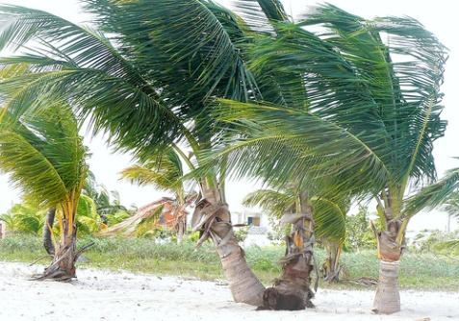
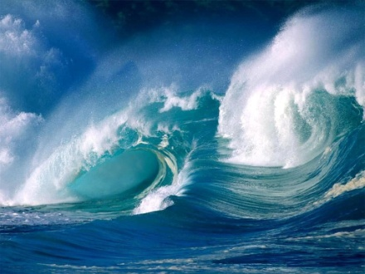
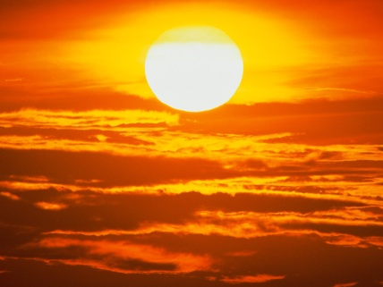
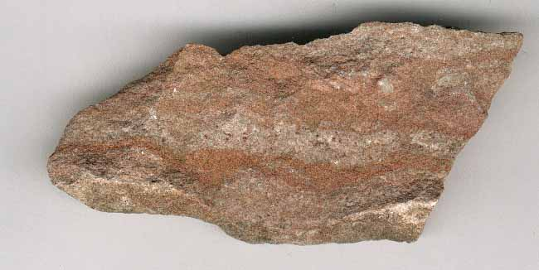
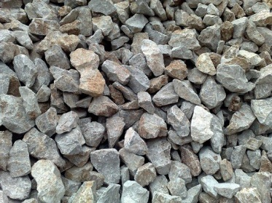
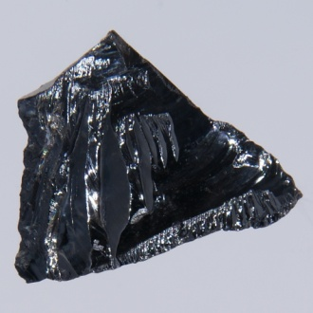
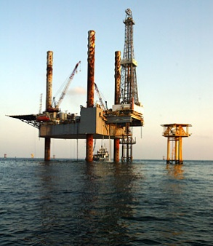
Florida’s Resources
Solar
Wind
Water
Phosphate
Limestone
Silicon
Oil
What are some uses of each resource? Which resources are renewable & which are nonrenewable?
SC.4.E.6.6
Notes:
Wind, Water, and Solar are renewable. Phosphate, Limestone, Silicon, and Oil are not. Uses will vary.
SC.4.E.6.6 Students will identify resources naturally found in Florida

Slide 41
Earth Science
Weathering, Erosion, Deposition

Slide 42
Benchmark Clarifications
SC.4.E.6.4 Students will identify and describe the processes of physical weathering and erosion. Students will compare and contrast the agents and the processes of physical weathering and erosion.

Slide 43
Weathering and Erosion
Weathering and Erosion
Think about:
What is one example of water weathering a surface? What is one example of water eroding a surface?
SC.4.E.6.4
Notes:
Short 3 minute video that clearly defines the relationship between the 2 processes. The video also goes into Chemical weathering which is not necessary but only takes a few moments.
SC.4.E.6.4 Students will identify and describe the processes of physical weathering and erosion. Students will compare and contrast the agents and the processes of physical weathering and erosion.

Slide 44
Earth Science
Water Cycle and States of Water

Slide 45
Benchmark Clarifications
SC.5.E.7.1 Students will identify and explain the parts of the water cycle. Students will identify the states of water associated with each part of the water cycle and explain the phase changes that occur as water moves from one part of the water cycle to another.
SC.5.E.7.2 Students will identify and describe the role of the ocean in the water cycle.

Slide 46
Water Cycle
Water Cycle Animation
Think about:
At which stages of the Water Cycle is water a solid, a liquid, or a gas?
SC.5.E.7.1
Notes:
Evaporation: gas, Condensation: liquid, Precipitation: liquid or solid
SC.5.E.7.1 Students will identify and explain the parts of the water cycle. Students will identify the states of water associated with each part of the water cycle and explain the phase changes that occur as water moves from one part of the water cycle to another.

Slide 47
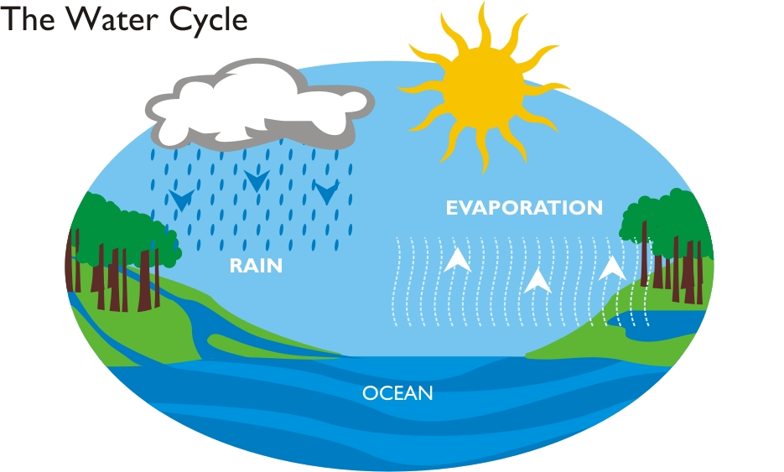
Ocean and the Water Cycle
Why is the ocean an important part of the Water Cycle?
SC.5.E.7.2
Notes:
The ocean holds the water that then evaporates when heated by the Sun
SC.5.E.7.2 Students will identify and describe the role of the ocean in the water cycle.

Slide 48
Earth Science
Regional Weather

Slide 49
Benchmark Clarifications
SC.5.E.7.3 Students will identify and describe how air temperature, barometric pressure, humidity, wind speed and direction, and precipitation describe weather in a particular place and time.
SC.5.E.7.4 Students will identify or distinguish the forms of precipitation (rain, snow, sleet, and hail) and their related weather conditions.
SC.5.E.7.5 Students will distinguish weather conditions among different environments.
SC.5.E.7.6 Students will describe the temperature and precipitation of different climate zones as they relate to latitude, elevation, and proximity to bodies of water.

Slide 50

Factors affecting Weather
Buffalo, NY
Temp: 20 degrees F
Wind: 30 mph SW
Pressure: 29.6 in
Humidity: 70%
Precipitation: Light Snow
Orlando, FL
Temp: 60 degrees F
Wind: 4 mph E
Pressure: 30.0 in
Humidity: 90%
Precipitation: Chance of Rain
Nairobi, Kenya
Temp: 85 degrees F
Wind: 12 mph NE
Pressure: 30.5 in
Humidity: 70%
Precipitation: None
In which city would you most want to be outside playing today? Explain your answer using the weather information above.
SC.5.E.7.3
Notes:
There is no intended correct answer, although Nairobi has the best overall weather conditions (moderate temperature, mild wind, no precipitation). Students may select Buffalo because it is snowing but they would need to consider that is it also very windy. Students may select Orlando because it is the least windy and the temperature is mild, but they should consider the high humidity and chance of rain.
May also want to mention that as the pressure increases, the chance of precipitation decreases (this is a typical pattern)
Good interactive resource: http://www.bbc.co.uk/schools/whatisweather/aboutweather/flash_menu.shtml
SC.5.E.7.3 Students will identify and describe how air temperature, barometric pressure, humidity, wind speed and direction, and precipitation describe weather in a particular place and time.

Slide 51
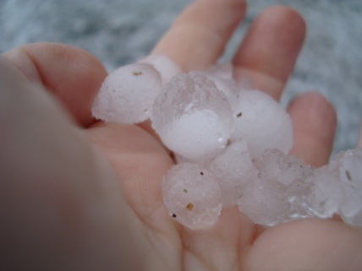
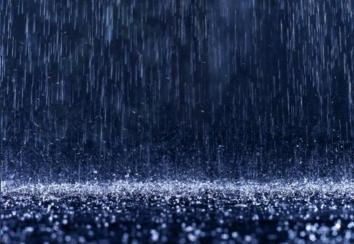
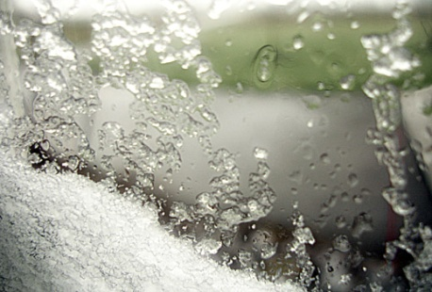
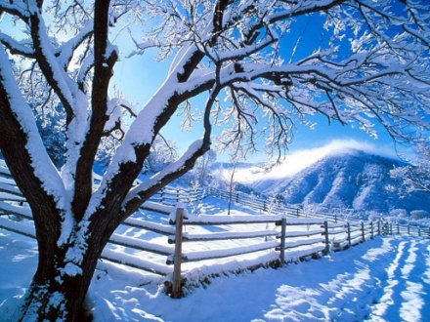
Forms of precipitation
Packed
ice crystals
Liquid water
Mixed liquid
and crystals
Soft Ice crystals
Label the images above as: rain, snow, sleet, or hail. Describe what weather conditions typically cause each type of precipitation
SC.5.E.7.4
Notes:
Use http://www.kidsgeo.com/geography-for-kids/0114-precipitation-types.php as a reference.
SC.5.E.7.4 Students will identify or distinguish the forms of precipitation (rain, snow, sleet, and hail) and their related weather conditions.

Slide 52
Environments
Environment Virtual Lab
Think about:
Which environment(s) are found most commonly near the equator? Which environment has the least precipitation?
SC.5.E.7.5
Notes:
Click on the city that is indicated in the chart below the map, then using the precipitation and temperature data determine its biome. Once the map is filled in, you can view short videos on each. For FCAT purposes, Taiga and Temperate Forest are not critical. There are a few versions of the map so it can be repeated for practice
SC.5.E.7.5 Students will distinguish weather conditions among different environments.

Slide 53
Climates
Interactive Climate Map
Think about:
For each climate listed, identify one example of a city with polar, tropical, and temperate climate. Explain why you believe these to be examples of each climate.
SC.5.E.7.6
Notes:
Polar: Russia; Antarctica; Alaska
Tropical: Peru, India, Senegal, Australia
Temperate: Chicago, Tennessee, Arizona, California, Algeria, China, Canada, England
SC.5.E.7.6 Students will describe the temperature and precipitation of different climate zones as they relate to latitude, elevation, and proximity to bodies of water.
Main determining factor is temperature (below 10 consistently = Polar, between 10-18 consistently = Temperate, above 18 year round = Tropical)

Slide 54
Physical Science
Solids, Liquids, and Gases

Slide 55
Benchmark Clarifications
SC.5.P.8.1 Students will compare and contrast the physical properties of solids, liquids, and gases. (SC.3.P.8.3, SC.4.P.8.1)
SC.3.P.8.1, SC.3.P.8.2 Students will describe or classify a material as a solid, liquid, or gas.

Slide 56
Properties of Solids, Liquids, and Gases
Solids, Liquids, and Gases
Think about:
How do solids, liquids, and gases respond differently to being placed in a new container?
SC.5.P.8.1, SC.3.P.8.3, SC.4.P.8.1
Notes:
Look at #2 (solids), #3 (liquids), #6 (gases), and #7 (all 3)…site allows you to stop, reverse, etc… to allow for discussion
SC.5.P.8.1 Students will compare and contrast the physical properties of solids, liquids, and gases. (SC.3.P.8.3, SC.4.P.8.1)

Slide 57
Categorizing Solids, Liquids, and Gases
Classifying Matter
Think about:
Were there any unexpected results? If so, explain.
SC.3.P.8.1, SC.3.P.8.2
Notes:
First part that requires sorting may get at some misconceptions about materials (etc sand as a solid), second part is not necessary as it begins the talk of evaporation but it is presented easily
SC.3.P.8.1, SC.3.P.8.2 Students will describe or classify a material as a solid, liquid, or gas.

Slide 58
Physical Science
Mixtures and dissolving in water

Slide 59
Benchmark Clarifications
SC.5.P.8.3 Students will describe and explain how mixtures of solids can be separated.
SC.5.P.8.2 Students will identify common materials that dissolve in water and identify or describe conditions that will speed up and slow down the dissolving process.

Slide 60
Separating Mixtures of Solids
Separating Mixtures
Think about:
What properties of the materials are used to separate them?
SC.5.P.8.3
Notes:
Recommend using the “You Try It” but not the quiz with most students as the concepts and vocabulary used are too difficult
SC.5.P.8.3 Students will describe and explain how mixtures of solids can be separated.

Slide 61
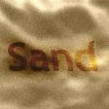
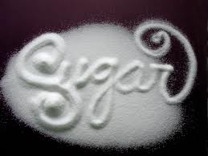
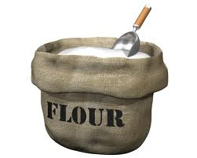
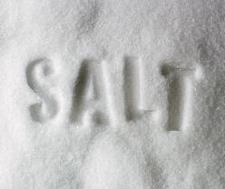
Dissolving in Water
Which of the substances above would dissolve in the beaker of water? How do you know?
SC.5.P.8.2
Notes:
This should be one they know, but easy to follow up with a lab as necessary (same for next 2 slides)
SC.5.P.8.2 Students will identify common materials that dissolve in water and identify or describe conditions that will speed up and slow down the dissolving process.

Slide 62
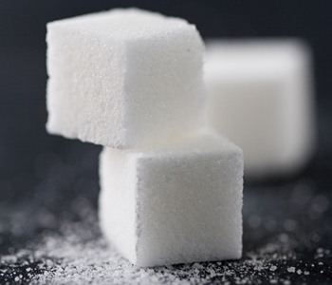
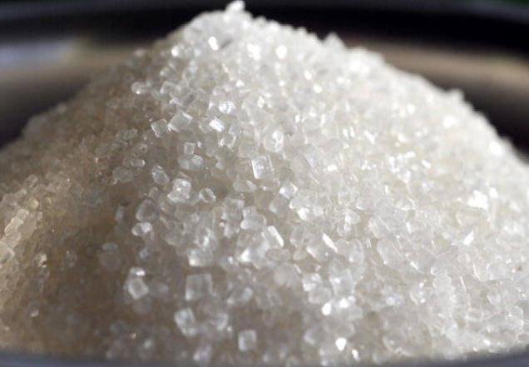
Dissolving in Water
Which of the forms of sugar would dissolve fastest in water? Explain why
SC.5.P.8.2
Notes:
Crystals because it is crushed up and has more surface area exposed to the water
SC.5.P.8.2 Students will identify common materials that dissolve in water and identify or describe conditions that will speed up and slow down the dissolving process.

Slide 63
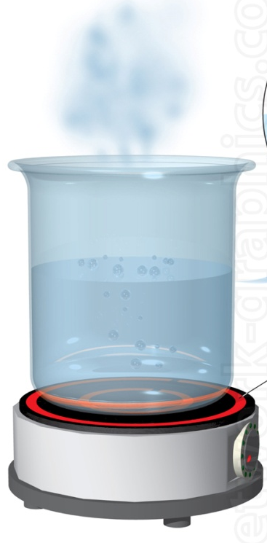
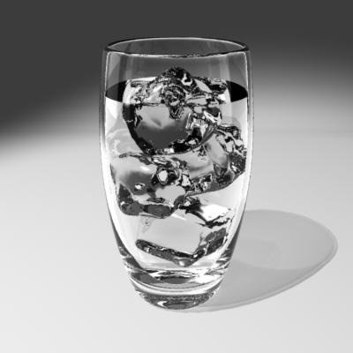
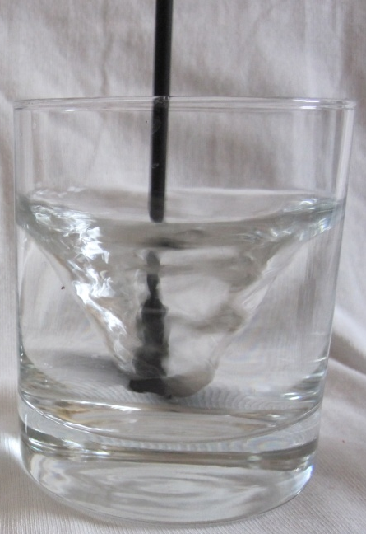
Dissolving in Water
Stirring the water
Cooling the water
Heating the water
Would the changes above speed up or slow down dissolving the sugar cube? Explain your answers.
SC.5.P.8.2
Notes:
Heating and stirring would speed it up. Cooling would slow it down.
SC.5.P.8.2 Students will identify common materials that dissolve in water and identify or describe conditions that will speed up and slow down the dissolving process.

Slide 64
Physical Science
Physical and Chemical Changes

Slide 65
Benchmark Clarifications
SC.5.P.9.1 Students will describe how physical and chemical changes are affected by temperature.
SC.3.P.9.1 Students will describe the physical changes water undergoes as it is heated and cooled.
SC.4.P.9.1 Students will describe how some familiar changes in materials result in other materials with different characteristics.

Slide 66
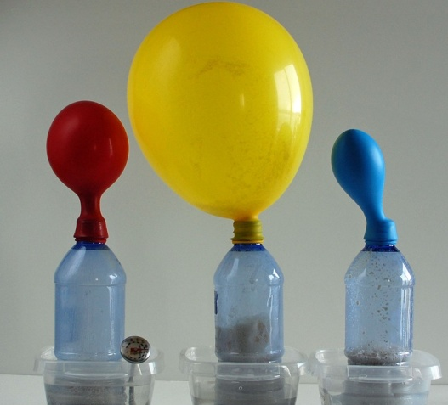
Changes affected by temperature
In the experiment below, water, yeast and sugar interact to create Carbon Dioxide gas. The picture shows the results after 10 minutes when different temperatures of water are used.
Video of Experiment
Which balloon is on the bottle with the hottest water? Explain your thinking.
SC.5.P.9.1
Notes:
Video is not necessary but explains what is happening in the experiment if you feel it is necessary. She even asks about changing the temperature as a follow up. The goal is to get the students to see that higher temperatures tend to speed up physical and chemical changes.
SC.5.P.9.1 Students will describe how physical and chemical changes are affected by temperature

Slide 67
Physical Changes of Water
Changing States
Think about:
What physical changes are happening to the water as it is heated and cooled?
SC.3.P.9.1
Notes:
Heating changes it from a liquid to a gas. Cooling changes it from a gas to a liquid, and from a liquid to a solid.
SC.3.P.9.1 Students will describe the physical changes water undergoes as it is heated and cooled.

Slide 68
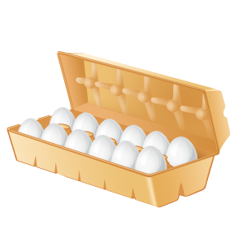
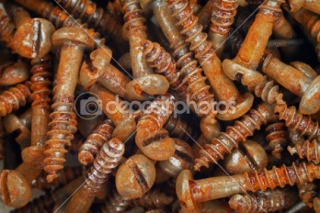
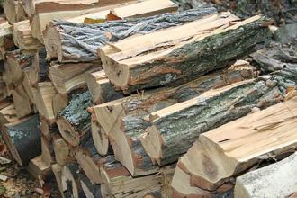
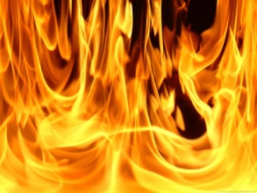
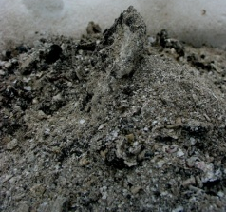
Chemical Changes
Explain why the images above are examples of Chemical Changes. Can you think of any other examples?
SC.4.P.9.1
Notes:
In each case, a new substance is created and there would be no way to recover the original substance. Additional examples may vary.
SC.4.P.9.1 Students will describe how some familiar changes in materials result in other materials with different characteristics.

Slide 69
Physical Science
Basic forms of Energy

Slide 70
Benchmark Clarifications
SC.5.P.10.1 Students will identify and describe some basic forms of energy. (SC.3.P.10.1, SC.3.P.11.1, SC.4.P.10.1)
SC.3.P.10.3 Students will describe that light travels in a straight line until it strikes an object or travels from one material to another. (SC.3.P.10.4 reflect, bend, or absorb)
SC.3.P.11.2 Students will explain that heat is produced when two objects are rubbed against each other.
SC.4.P.10.3 Students will explain that sound is produced by vibrations and that pitch depends on how fast or slow the object vibrates.

Slide 71
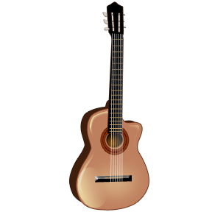
Forms of Energy
Which type(s) of energy are related to each of the pictures above? Explain your choices.
SC.5.P.10.1 (SC.3.P.10.1, SC.3.P.11.1, SC.4.P.10.1)
Notes:
Students should choose between sound, light, heat, mechanical, chemical, and electrical
Potential answers: Light bulb: light (electrical and heat), Outlet: electrical, Stove: heat (electrical and light), Food: chemical, Guitar: sound (and mechanical), Fan: mechanical (and electrical)
SC.5.P.10.1 Students will identify and describe some basic forms of energy. (SC.3.P.10.1, SC.3.P.11.1, SC.4.P.10.1)

Slide 72
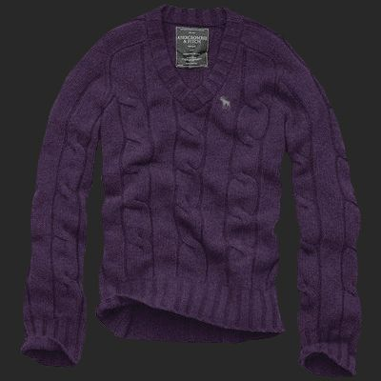
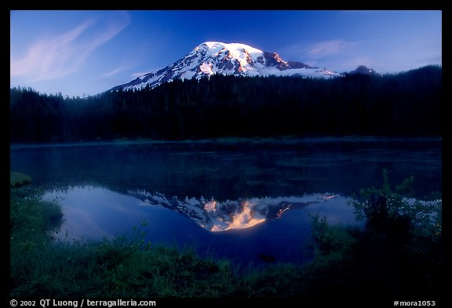
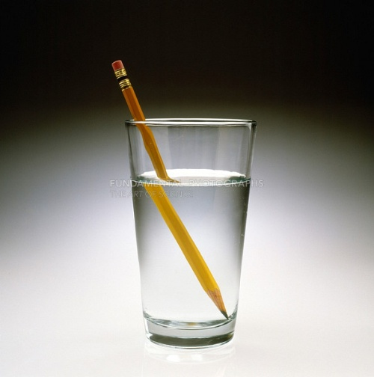
Reflect, Refract (Bend), Absorb
The reason the shirt appears purple?
The reason the image of the mountain is visible on the surface of the water?
The reason the pencil appears broken?
SC.3.P.10.3, SC.3.P.10.4
Notes:
Purple Shirt: Absorbs light; Mountain: the water is Reflecting light; Pencil: the water is bending/refracting light
SC.3.P.10.3 Students will describe that light travels in a straight line until it strikes an object or travels from one material to another. (SC.3.P.10.4 reflect, bend, or absorb)

Slide 73
Friction
Friction and Temperature
Think about:
What is another way you can demonstrate this concept?
SC.3.P.11.2
Notes:
Click on the Chemistry book and rub it against the Physics book and you should see the temperature increase…if it gets really high, particles will come off which you can explain by asking them what would happen if you rub a wet paper towel on a rug (or other example). Students can easily demonstrate this concept by rubbing their hands together. “Friction” is not a required term but is sort of unavoidable.
SC.3.P.11.2 Students will explain that heat is produced when two objects are rubbed against each other.

Slide 74
Sound
Sound Simulator
Think about:
When you adjust the “frequency” button what changes about the vibrations? What changes about the sound?
SC.4.P.10.3
Notes:
This simulator has a LOT more to it than you will need to use. Keep it on the first tab which just has a speaker and listener. You have to click on Enable Audio to be able to hear the sound. Adjusting Amplitude changes how loud the sound is, adjusting frequency changes the pitch. Students need to learn that the speaker is vibrating which causes the sound (shown in this case by the semi-circle lines leaving the speaker) and that if it vibrates faster, the pitch gets higher and if it vibrates slower, the pitch gets lower.
SC.4.P.10.3 Students will explain that sound is produced by vibrations and that pitch depends on how fast or slow the object vibrates.

Slide 75
Physical Science
Energy causes motion and change

Slide 76
Benchmark Clarifications
SC.5.P.10.2 Students will explain that energy has the ability to cause motion or create change. Students will identify and describe examples where energy has caused motion or created changes. (SC.3.P.10.2, SC.4.P.10.2)
SC.4.P.10.4 Students will describe and explain how water and air are sources of energy.

Slide 77
Energy causing Motion
Energy Skate Park
Think about:
What happens to the energy of the skater as he travels along the track? What happens to his energy as you change the track?
SC.5.P.10.2 (SC.3.P.10.2, SC.4.P.10.2)
Notes:
The simulation has a LOT that is beyond the scope of this benchmark so feel free to keep it simple. Suggest clicking on the bar graph which shows the potential and kinetic energy as well as the overall energy (shows how the overall stays the same while the others change inversely). Can add to the track and change the height of the hills to show how the energy changes.
SC.5.P.10.2 Students will explain that energy has the ability to cause motion or create change. Students will identify and describe examples where energy has caused motion or created changes. (SC.3.P.10.2, SC.4.P.10.2)

Slide 78
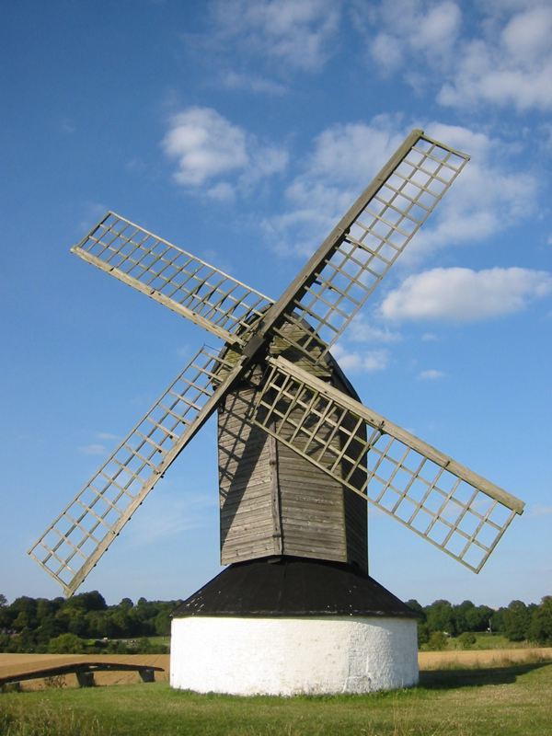
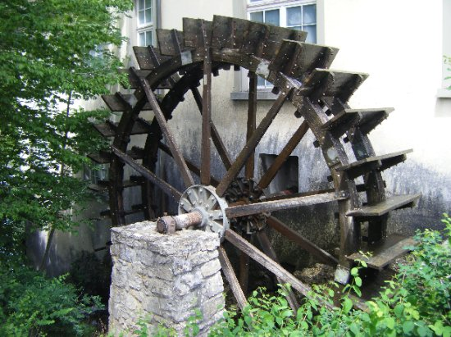
Wind and Water
How are wind and water used in the machines above?
SC.4.P.10.4
Notes:
Students should explain that the wind/water turns the windmill/watermill blades which uses motion to create energy (the details are not necessary)
SC.4.P.10.4 Students will describe and explain how water and air are sources of energy.

Slide 79
Physical Science
Energy and Heat

Slide 80
Benchmark Clarifications
SC.5.P.10.4 Students will explain that electrical energy can be transformed into heat, light, and sound energy, as well as the energy of motion.
SC.3.E.6.1 Students will explain that energy from the Sun can be used to heat objects, and that when sunlight is not present, heat may be lost.
SC.4.P.11.1 Students will identify the flow of heat between hot and cold objects and that heat may cause objects to change temperature.
SC.4.P.11.2 Students will identify common materials that conduct heat well or poorly.
SC.5.P.10.3 Students will explain that an electrically charged object can attract an uncharged object and either attract or repel another charged object without any contact between the objects.
SC.5.P.11.1 Students will determine that the flow of electricity requires a closed circuit.
SC.5.P.11.2 Students will identify and classify materials that conduct electricity and materials that do not.

Slide 81
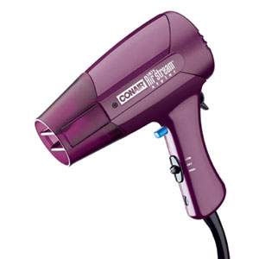
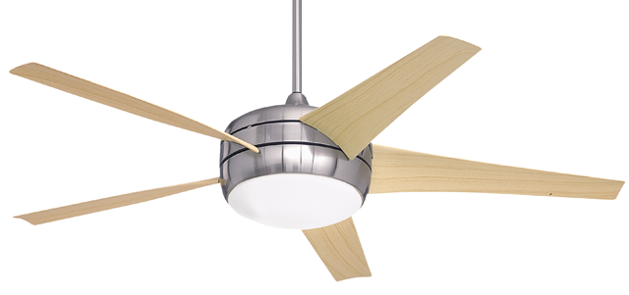
Transforming Electrical Energy
Do the objects above change electrical energy into heat, light, sound, and/or motion energy? Explain your choices.
SC.5.P.10.4
Notes:
Hairdryer: heat and sound (and motion potentially if they consider the parts on the inside) Fan: light and motion (and sound potentially if it’s a fan that makes noise when it turns)
SC.5.P.10.4 Students will explain that electrical energy can be transformed into heat, light, and sound energy, as well as the energy of motion.

Slide 82
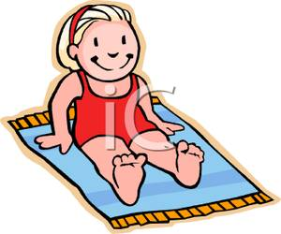
Heat from the Sun
Even though these girls are at the same beach, one of them feels cooler than the other? Who feels cooler and why?
SC.3.E.6.1
Notes:
Under the umbrella is cooler because the Sun’s heat is no longer hitting her directly
SC.3.E.6.1 Students will explain that energy from the Sun can be used to heat objects, and that when sunlight is not present, heat may be lost.

Slide 83
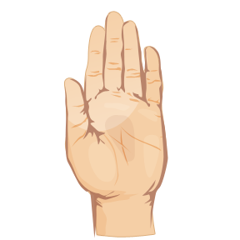
Movement of Heat
Cold moves to hand
?
Hot moves to ice cream
When you hold an ice cream cone, your hand starts to feel cold and the ice cream melts. Which arrow above correctly explains why this happens? Explain
SC.4.P.11.1
Notes:
Hot moves to ice cream. Heat always flows from a warmer object to a cooler one. Your hand feels cold because it is loosing heat to the ice cream.
SC.4.P.11.1 Students will identify the flow of heat between hot and cold objects and that heat may cause objects to change temperature.

Slide 84
Conducting Heat
Keeping Warm
Think about:
Was metal a good insulator or bad? Explain how you know. Why are our cooking pans made out of metal?
SC.4.P.11.2
Notes:
Metal is a poor insulator. It conducts heat well which is why it is used in pots…it quickly transfers the heat from the burner to the food.
SC.4.P.11.2 Students will identify common materials that conduct heat well or poorly.

Slide 85
Charged Objects
Static Electricity
Think about:
What happens when objects with the same charge get close? What happens when objects with opposite charges get close?
SC.5.P.10.3
Notes:
Have the students observe the interaction of the uncharged balloon, sweater, and wall. Then rub the balloon against the sweater and observe that the now negatively charged balloon is attracted to the positively charged sweater. They should also see a reaction to the wall. You can add a second balloon which shows some more interactions especially if you charge both balloons (you will watch them repel)
SC.5.P.10.3 Students will explain that an electrically charged object can attract an uncharged object and either attract or repel another charged object without any contact between the objects.

Slide 86
Electric Circuits
Circuit Construction
Think about:
What happens if the circuit is not closed?
What happens if the circuit is not correctly connected?
SC.5.P.11.1
Notes:
The simulator has MANY more options than are needed. You can get as complex as the kids want. To start over just hit Reset. In the Grab Bag, there are objects that can be added to the circuit to test conductivity.
SC.5.P.11.1 Students will determine that the flow of electricity requires a closed circuit.

Slide 87
Electric Conductors
Circuits and Conductors
Think about:
What types of materials conduct electricity and what types do not?
SC.5.P.11.2
Notes:
Basic circuit activity where students insert an object into a circuit to see if the bulb lights…also goes into basics of creating circuits so it’s a good intro to the next slide
SC.5.P.11.2 Students will identify and classify materials that conduct electricity and materials that do not.

Slide 88
Physical Science
Forces
(esp. Gravity and Magnets)

Slide 89
Benchmark Clarifications
SC.5.P.13.1 Students will identify familiar forces that affect how objects move.
SC.3.E.5.4 Students will identify scenarios whereby gravity is overcome.
SC.4.P.8.4 Students will identify and/or describe examples of magnetic attraction and repulsion.

Slide 90
Push, Pull, and Friction
Friction
Think about:
With which surface was friction the lowest? How do you know?
SC.5.P.13.1
Notes:
Following the instructions at the top of the box should be helpful. Students should see that the greater the push, the greater the distance traveled and that if the surface is smoother (less friction) the greater the distance traveled.
SC.5.P.13.1 Students will identify familiar forces that affect how objects move.

Slide 91
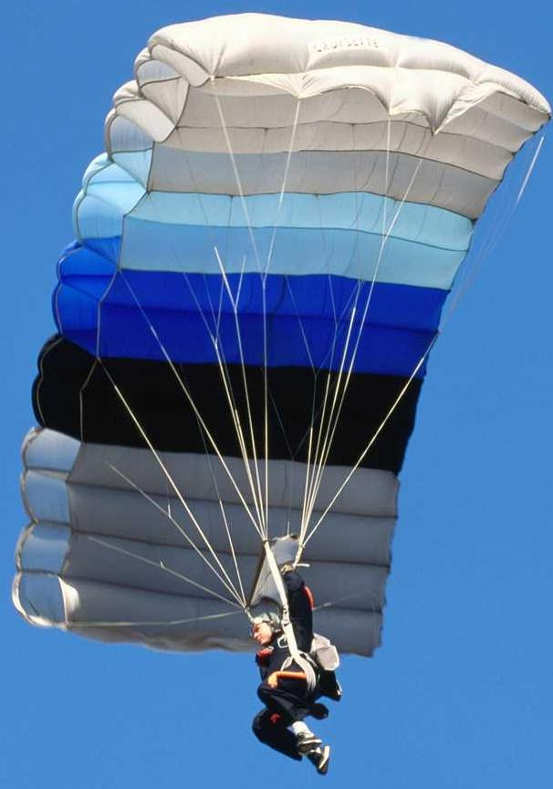
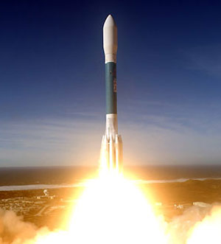
Gravity
Explain how the objects are able to change the effect of the force of gravity.
SC.3.E.5.4
Notes:
Students should discuss how the parachute increases friction (air resistance) which resists the falling motion created by gravity. Students should discuss how the rockets engines create enough force to reduce the effect of the pull of gravity.
SC.3.E.5.4 Students will identify scenarios whereby gravity is overcome.

Slide 92
Magnets
Magnets
Think about:
Did rotating the magnet affect whether it attracted the objects? Explain.
SC.4.P.8.4
Notes:
Following the steps at the top of the box will walk you through the process. Kids should see that rotating the magnet only affected how it interacted with the magnet on the bottom, not the other objects like the key or paperclip.
SC.4.P.8.4 Students will identify and/or describe examples of magnetic attraction and repulsion.

Slide 93
Physical Science
Motion

Slide 94
Benchmark Clarifications
SC.5.P.13.2 Students will describe the relationship among mass, force, and motion. (SC.5.P.13.3, SC.5.P.13.4)
SC.4.P.12.1 Students will identify and describe that an object in motion always changes its position and may change its direction.
SC.4.P.12.2 Students will describe that the speed of an object is determined by the distance an object travels and the time it takes the object to travel that distance. Students will describe that objects can move at different speeds.

Slide 95
Mass, Force, and Motion
Forces in Action
Think about:
What affect did changing the mass have on the motion of the car?
SC.5.P.13.2 (SC.5.P.13.3, SC.5.P.13.4)
Notes:
Follow the steps. Students should see that the more mass, the less motion if the force is the same. The more force, the greater motion.
SC.5.P.13.2 Students will describe the relationship among mass, force, and motion. (SC.5.P.13.3, SC.5.P.13.4)

Slide 96
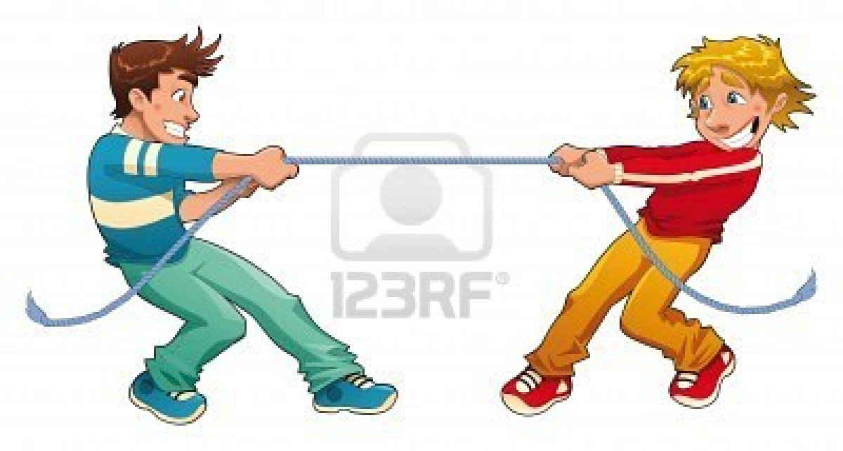
Balanced/Unbalanced Forces
If the rope above does not move, what does that mean about the force that each boy is pulling with?
SC.5.P.13.2 (SC.5.P.13.3, SC.5.P.13.4)
Notes:
Students should know that the forces are equal but opposite
SC.5.P.13.2 Students will describe the relationship among mass, force, and motion. (SC.5.P.13.3, SC.5.P.13.4)

Slide 97

Motion: Position and Direction
A
B
C
The image above shows a person walking along a street. Compare the position and direction (same or different) of Person B and Person C to Person A.
SC.4.P.12.1
Notes:
B has different position but same direction. C has different position and direction.
SC.4.P.12.1 Students will identify and describe that an object in motion always changes its position and may change its direction

Slide 98
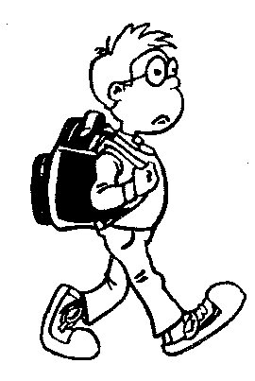

Speed
Sam
Oliver
Sam and Oliver are heading to school. They both have to travel 1 ½ miles. What information would you need to know to figure out how fast they are going?
SC.4.P.12.2
Notes:
Students should know that they would need the time it took them to get to school.
SC.4.P.12.2 Students will describe that the speed of an object is determined by the distance an object travels and the time it takes the object to travel that distance. Students will describe that objects can move at different speeds.

Slide 99
Life Science
Plants

Slide 100
Benchmark Clarifications
SC.3.L.14.1 Students will identify and describe the parts of plants and the part’s role.
SC.3.L.14.2 Students will describe how plants respond to stimuli.
SC.4.L.16.1 Students will describe processes of sexual reproduction in flowering plants.

Slide 101
Plant Parts
Plant Part Animation
Think about:
How do the parts of a plant work together?
SC.3.L.14.1
Notes:
Basic review of plant parts and function
SC.3.L.14.1 Students will identify and describe the parts of plants and the part’s role.

Slide 102
Responding to Simuli
Plants in Motion
Think about:
How are the plants responding to light and gravity?
SC.3.L.13.2
Notes:
Rather small video clips but very clear examples of plants reacting to stimuli
SC.3.L.14.2 Students will describe how plants respond to stimuli.

Slide 103
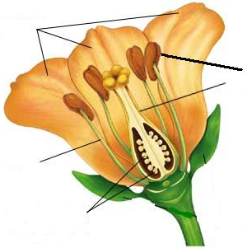
Plant Reproduction
Petals
1
Pollen
5
Attract insects
Similar to sperm
Pistil
4
Stamen
2
Female part, receives pollen
Male part, makes pollen
Ovary with Eggs
3
Eggs become seeds,
ovary becomes fruit
SC.4.L.16.1
Notes:
Click each part one at a time asking students to identify the parts and their function…the terms that are included are based on the FCAT Test item specifications
SC.4.L.16.1 Students will describe processes of sexual reproduction in flowering plants.

Slide 104
Life Science
Human Body

Slide 105
Benchmark Clarifications
SC.5.L.14.1 Students will identify organs in the human body and describe their functions.

Slide 106
Human Body: Organs
Organs with Information
Identifying Organs (no function)
Think about:
What are the functions of the various organs?
SC.5.L.14.1
Notes:
Good information on the organs, goes into the systems too but that is not necessary for this benchmark. The first link has the organs identified and students just click to find out more information. Second link allows them to practice identifying the organs.
SC.5.L.14.1 Students will identify organs in the human body and describe their functions

Slide 107
Life Science
Comparing and Classifying
Plants and Animals

Slide 108
Benchmark Clarifications
SC.5.L.14.2 Students will compare and contrast the function of organs and other physical structures of plants and animals.
SC.3.L.15.1 Students will classify animals into major groups according to their physical characteristics and behaviors.
SC.3.L.15.2 Students will classify flowering and non-flowering plants into major groups according to their physical characteristics.

Slide 109
Animal classification
Classification Matching Game
Animal Classification Quiz
Think about
-Are there any invertebrates that have an endoskeleton? If yes, give one example.
-Are there any vertebrates that have an exoskeleton?
If yes, give one example.
SC.3.L.15.1
Notes:
Both links go to a review type game. Each time you play, the categories/terms are different, good review of basic classification
A jellyfish would be an example of an invertebrate with an endoskeleton (water based), there are no vertebrates with exoskeletons (that would mean their bones are outside their body, turtles are common misconception because their spines are attached to their shells)
SC.3.L.15.1 Students will classify animals into major groups according to their physical characteristics and behaviors.

Slide 110
Plant classification
Plant Classification Quiz
Think about:
What are the main features used to distinguish between types of plants?
SC.3.L.15.2
Notes:
Matching game concerning plant types. Goal is to get the students to see that reproductive method (ex flowers vs cones) and structure (ex stems vs no stem) are the main distinguishing features used in plant classification
SC.3.L.15.2 Students will classify flowering and non-flowering plants into major groups according to their physical characteristics.

Slide 111
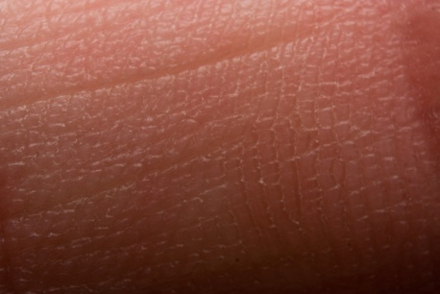
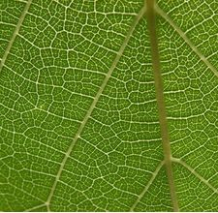
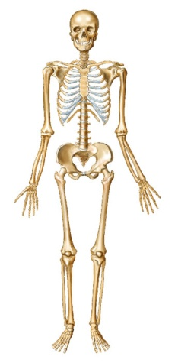
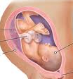
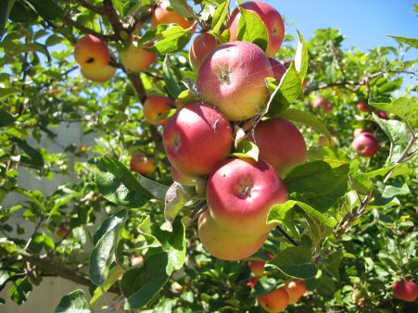
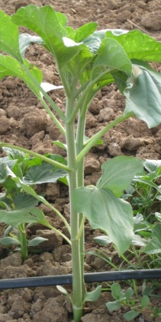
Plant and Animal Comparison
How are these structures similar/different?
SC.5.L.14.2
Notes:
Lead students through a comparison of the animal and plant parts with a focus on skin vs plant covering, skeleton vs stem, and reproductive organs vs flower and fruit
SC.5.L.14.2 Students will compare and contrast the function of organs and other physical structures of plants and animals.

Slide 112
Life Science
Life Cycles of Plants and Animals

Slide 113
Benchmark Clarifications
SC.4.L.16.4 Students will identify, compare, and contrast the major life cycles of Florida plants and animals.

Slide 114
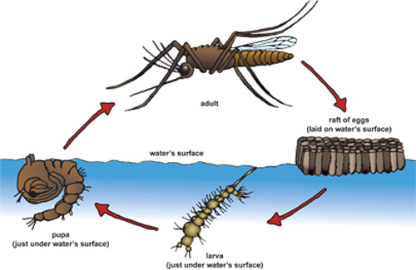


Life Cycles
Mosquito
Chicken
Oak Tree
Compare and contrast the life cycles of these living things. What other animals or plants have similar life cycles?
SC.4.L.16.4
Notes:
For a more interactive version: http://www.fossweb.com/modules3-6/StructuresofLife/activities/lifecycles.html
SC.4.L.16.4 Students will identify, compare, and contrast the major life cycles of Florida plants and animals

Slide 115
Life Science
Plant and Animal Adaptations, Characteristics, and Impact

Slide 116
Benchmark Clarifications
SC.5.L.17.1 Students will explain, compare, and contrast how adaptations displayed by animals or plants enable them to survive in different environments.
SC.5.L.15.1 Students will describe how, when the environment changes, differences between organisms allow some plants and animals to survive and reproduce while others die or move to new locations.
----------------------------------------------------------------------------------------------------------
SC.3.L.17.1 Students will describe or explain how animals and plants respond to changing seasons.
SC.4.L.17.1 Students will compare the seasonal changes in Florida plants and animals to those in other regions of the country.
-----------------------------------------------------------------------------------------------------------
SC.4.L.16.2 Students will distinguish plant or animal characteristics that are inherited from those that are affected by the environment.
SC.4.L.16.3 Students will identify characteristics of animals that are inherited or distinguish inherited characteristics from those that are shaped by learning.
----------------------------------------------------------------------------------------------------------
SC.4.L.17.4 Students will identify ways in which plants and animals can impact the environment.

Slide 117
Adaptations
Animal Adaptations
Think about:
Can any of the adaptations shown, help with multiple basic needs? If yes, give an example and explain.
SC.5.L.17.1, SC.5.L.15.1
Notes:
There are several sets of animals so playing more than once gives more practice
SC.5.L.17.1 Students will explain, compare, and contrast how adaptations displayed by animals or plants enable them to survive in different environments.
SC.5.L.15.1 Students will describe how, when the environment changes, differences between organisms allow some plants and animals to survive and reproduce while others die or move to new locations.

Slide 118


Seasonal Changes
Explain how these two living things react to changing seasons. Would their reactions be the same in northern states as they are here in Florida?
SC.3.L.17.1, SC.4.L.17.1
Notes:
Looking for leaf color changes, dropping leaves, flowering, etc for tree. Looking for hibernation, fur growth, eating changes, having babies, etc for bear. Distinguish between reactions of animals to drastic temperature changes (north) and more subtle changes (Florida)
SC.3.L.17.1 Students will describe or explain how animals and plants respond to changing seasons.
SC.4.L.17.1 Students will compare the seasonal changes in Florida plants and animals to those in other regions of the country.

Slide 119






Inherited vs. Learned Characteristics
Color of eyes
Balancing on a barrel
Length of tail
Size of ears
Waterskiing
Riding a bike
Which characteristics above were inherited and which were learned? Explain your choices.
SC.4.L.16.2, SC.4.L.16.3
Notes:
Inherited characteristics: Color of eyes, Length of tail, Size of ears (these are all traits which are determined by genetics)
Learned characteristics: Balancing, waterskiing, riding a bike (these are all behaviors that must be taught, a parent cant pass the ability on genetically)
SC.4.L.16.2 Students will distinguish plant or animal characteristics that are inherited from those that are affected by the environment.
SC.4.L.16.3 Students will identify characteristics of animals that are inherited or distinguish inherited characteristics from those that are shaped by learning.

Slide 120



Impact on Environment
Bee getting pollen from a flower
Monkey eating fruit in a tree
Sea grass growing on a sand dune at the beach
Explain how the animals and plants in the scenarios shown above are impacting their environment.
SC.4.L.17.4
Notes:
Bee is helping distribute pollen and therefore assist in plant fertilization. Monkey drops seeds as he eats the fruit which helps in planting new trees (also when the seeds are dropped in feces this helps with growth). Sea grass helps to hold the sand together and prevents erosion, also provides homes for some animals.
SC.4.L.17.4 Students will identify ways in which plants and animals can impact the environment.

Slide 121
Life Science
Food Chains and Energy

Slide 122
Benchmark Clarifications
SC.4.L.17.3 Students will describe or explain how energy is transferred from the Sun through a food chain.
SC.3.L.17.2 Students will explain that plants make their own food using carbon dioxide, water, and energy from the Sun.
SC.4.L.17.2 Students will explain that animals obtain energy from the plants and animals they eat.

Slide 123
Energy transfer in a food chain
Energy in a food chain
Think about:
-Which members of the food chain get their energy directly from the Sun?
- Which members of the food chain get their energy from other living things?
SC.4.L.17.3
Notes:
Producers (Plants) get their energy directly from the Sun. Consumers (animals typically) get their energy from organisms.
SC.4.L.17.3 Students will describe or explain how energy is transferred from the Sun through a food chain

Slide 124
How plants make food
Photosynthesis
Think about:
-What are the 3 things that plants require to make their food?
-Can plants grow without soil? Explain.
SC.3.L.17.2
Notes:
Sunlight, air, and water. Plants CAN grow without soil as long as they have enough of the required elements to photosynthesize. You can point out air plants that grow on trees or hydroponics
SC.3.L.17.2 Students will explain that plants make their own food using carbon dioxide, water, and energy from the Sun.

Slide 125
How animals get food
Food Chains
Think about:
-What is the difference between a consumer that is an herbivore and a consumer that is a carnivore?
-Can an animal be a producer? Explain.
SC.4.L.17.2
Notes:
Herbivore consumers only eat plants. Carnivore consumers eat animals. Animals can not be producers because they can not make their own food from the Sun’s energy
SC.4.L.17.2 Students will explain that animals obtain energy from the plants and animals they eat

Slide 126
Reminders
This presentation is meant to highlight the concepts as they will be assessed in FCAT 2.0
You should NOT use this presentation to limit your instruction as there are many critical topics needed to support the ideas on the slides that are not directly assessed

Slide 127
Main Resources
Most of the simulations were pulled from these sites:
http://www.bbc.co.uk/bitesize/
http://www.bbc.co.uk/schools/scienceclips/index_flash.shtml
http://phet.colorado.edu/en/simulations/category/new
http://www.uen.org/3-6interactives/science.shtml

Slide 128
Questions/Concerns/Comments
Email: rachel_hallett@scps.us
Phone: 50189

